Slide 1
Tungsten Supplier submission
September 2018

Slide 2
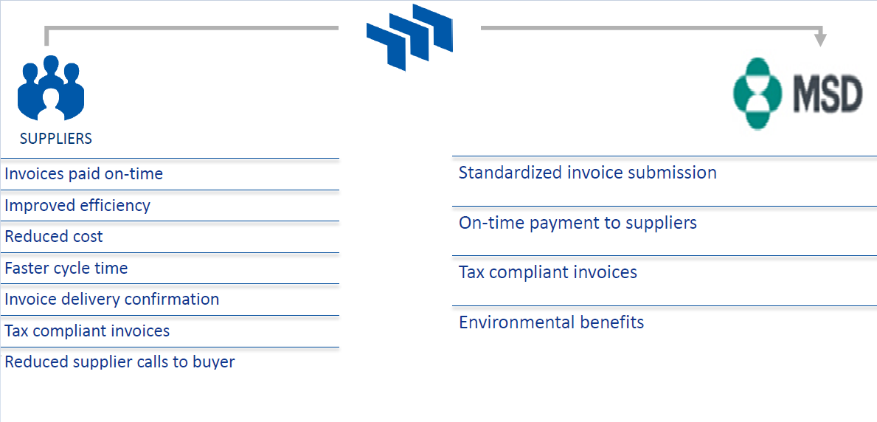
Tungsten Benefits for Suppliers

Slide 3
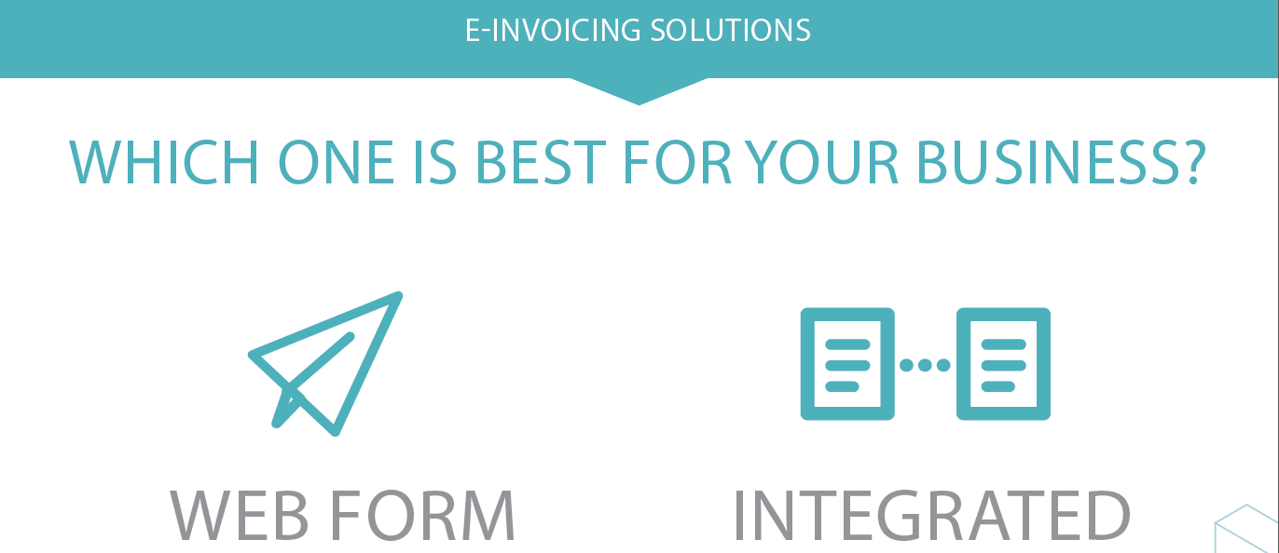
Tungsten´s E-invoicing Solutions

Slide 4
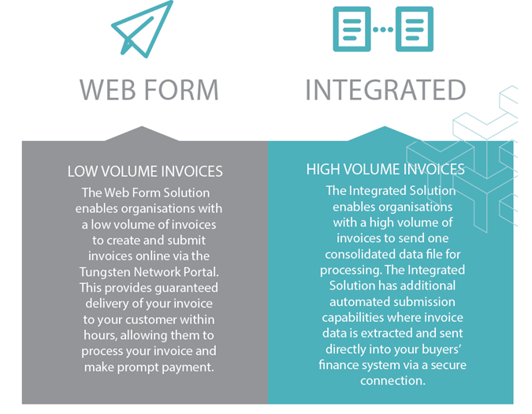
Tungsten´s E-invoicing Solutions
Supplier to fill-in the initial form, TN to allocate the resource to help Supplier with onboarding activities
Supplier to self-register on the Portal
> 52 invoices / year - free
< 52 invoices / year
(Anual membership 1.250 EUR, limit of 520 invoices)

Slide 5
Solution Costs

Slide 6
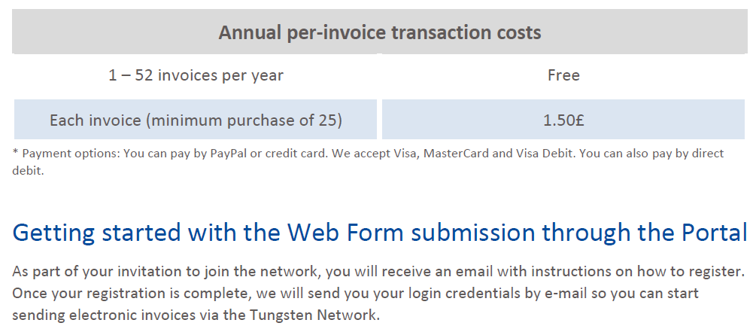
Costs for the Web Form
*Prices might differ based on country. Please visit https://www.tungsten-network.com/uk/solutions-for-suppliers/e-invoicing/enrol-for-web-form/ for the actual prices

Slide 7
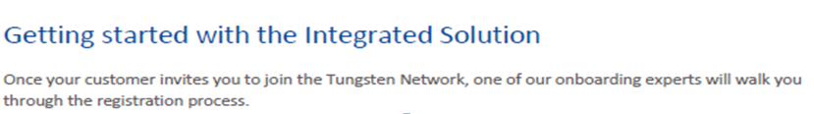
Costs for Integrated Solution
Annual Cost
*Prices might differ based on country. Please visit https://www.tungsten-network.com/uk/solutions-for-suppliers/e-invoicing/enrol-for-integrated-solution/ for the actual prices

Slide 8
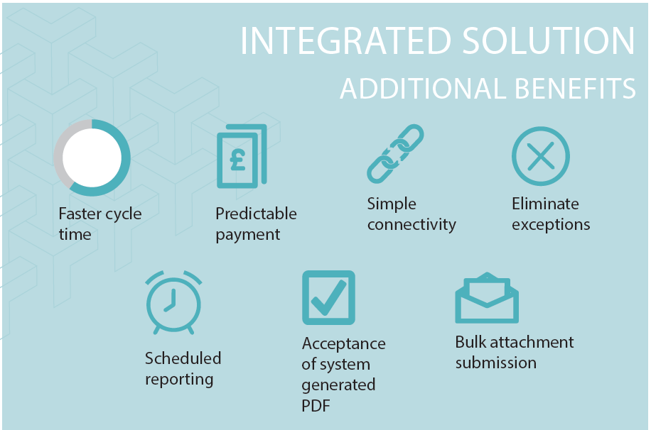
Extra Benefits of Integrated Solution

Slide 9
Tungsten Enrolment
Web Form Solution | Integrated Solution
1) Expected annual invoice volume is up to 52 invoices per year, vendor to self-register directly on the web | 1) Expected annual invoice volume is 52+ invoice per year.
2) Attached word template to be filled in | 2) Attached excel sheet to be completed
3) Vendor to self-register directly on the web | 3) BSC Prague to get in touch with Tungsten contact and they will then get a resource from their enrolment team to contact supplier directly or the supplier can contact the TN Sales team directly.

